Slide 1
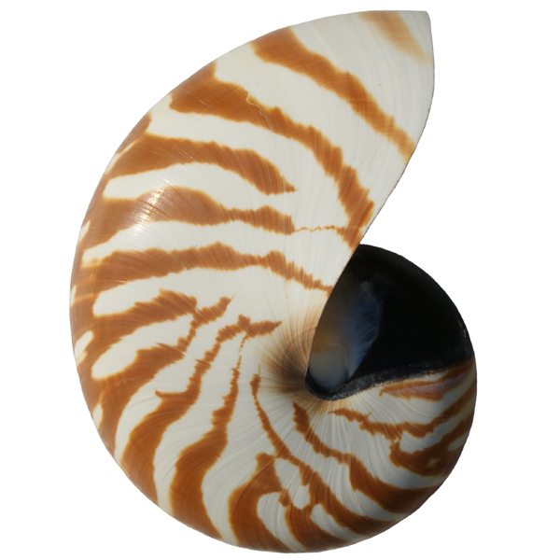
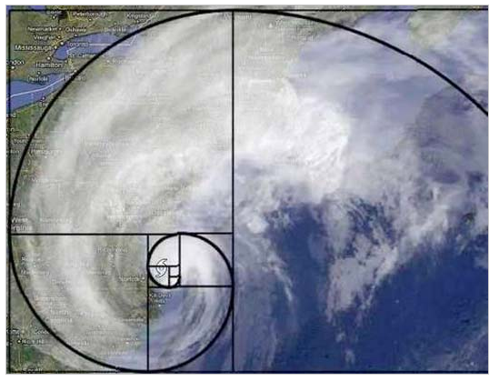
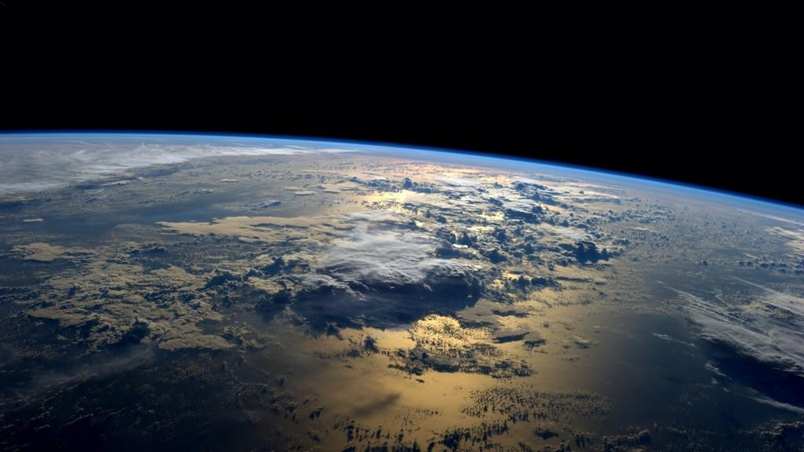
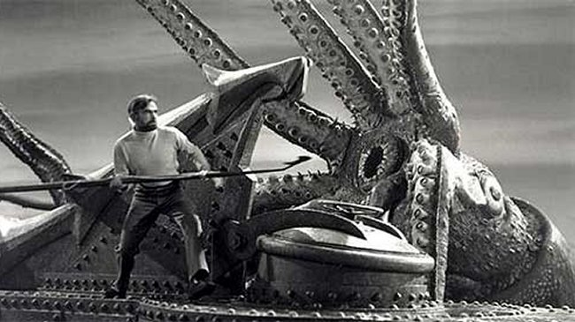
CS 46B: Data Structures Module 16: Addition
Professor Phil Heller

Slide 2
w + x + y + z
Are any of
w/x/y/z
Strings?
No Yes
Numeric String
Context context

Slide 3
Numeric Addition Context
Nothing special, same as any arithmetic in Java
+ means add
Operations: + - * / % << >> >>>
Operands: numeric variables or literals

Slide 4
Literal Numbers
Numbers that aren’t variables
Runs of digits
Optional sign, decimal point, base, type
42 , -123, 3.14159, 07655, 0x13da, 5L, 6D, 7F

Slide 5
Numeric Literal | Type
42 | int
3.14159 | double
3.14159f or 1.14159F | float
42L | long
023 (zero, not oh) | int, base 8
0x45ac | int, base 16 (a-f = 10-15)

Slide 6
Some cool hex numbers
0xd00d1e
0xc0ffee
0xdecaf
0xba5eba11
0xf007ba11
0xca5cade
0xdead

Slide 7

Some cool hex numbers
0xd00d1e
0xc0ffee
0xdecaf
0xba5eba11
0xf007ba11
0xca5cade
0xfeeb1e
0xdead

Slide 8

Some cool hex numbers
0xd00d1e
0xc0ffee
0xdecaf
0xba5eba11
0xf007ba11
0xca5cade
0xfeeb1e
0xdead

Slide 9
Some cool hex numbers
0xd00d1e
0xc0ffee
0xdecaf
0xba5eba11
0xf007ba11
0xca5cade
0xfeeb1e
0xdead

Slide 10
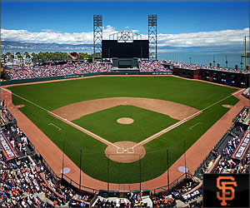
Some cool hex numbers
0xd00d1e
0xc0ffee
0xdecaf
0xba5eba11
0xf007ba11
0xca5cade
0xfeeb1e
0xdead

Slide 11
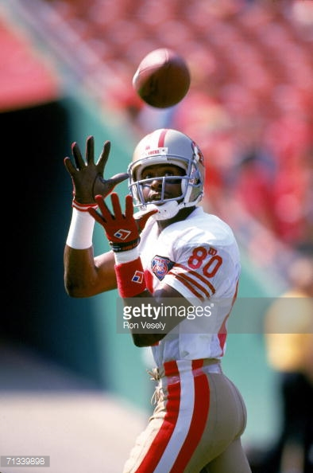
Some cool hex numbers
0xd00d1e
0xc0ffee
0xdecaf
0xba5eba11
0xf007ba11
0xca5cade
0xfeeb1e
0xdead

Slide 12

Some cool hex numbers
0xd00d1e
0xc0ffee
0xdecaf
0xba5eba11
0xf007ba11
0xca5cade
0xfeeb1e
0xdead

Slide 13

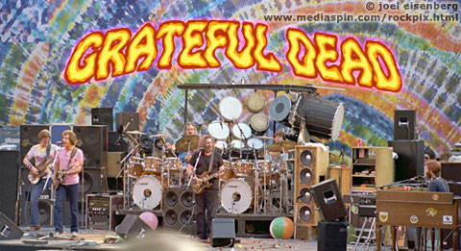
Some cool hex numbers
0xd00d1e
0xc0ffee
0xdecaf
0xba5eba11
0xf007ba11
0xca5cade
0xdead

Slide 14
Width of numeric types
byte, short, int, long, float, double
x = y is legal if the type of x is the same as or wider than the type of y.
“Wider than” isn’t what you might think
Ignore # of bits in the data types
Think about range of the data types
Type A is wider than type B if the range of values represented by A contains the range of values represented by B
Notes:
“width” is official and confusing. I wish they had given it a better name.

Slide 15
Which is wider?
Type | # bits | Range
byte | 8 | -128 to +127
short | 16 | -32,768 to +32767
int | 32 | -2,147,483,648 to +2,147,483,647
long | 64 | -9,223,372,036,854,775,808 to +9,223,372,036,854,775,807
float | 32 | -3.4E38 to +3.4E38
double | 64 | -1.8E308 to +1.8E308
byte or short?
byte or long?
float or long?

Slide 16
Which is wider: byte or short?
Type | # bits | Range
byte | 8 | -128 to +127
short | 16 | -32,768 to +32767
-128 0 127
Not to scale!
-32,678 0 32,767
Notes:
Every possible byte value can be represented by a short

Slide 17
How Java adds a + b
a and b can be variables or literals.
If a is a byte or a short, convert it to an int.
If b is a byte or a short, convert it to an int.
If type of a is narrower than type of b, convert (widen) a to type of b.
If type of b is narrower than type of a, convert (widen) b to type of a.
Now both args are same type, and that type is int or wider.
Type of result will be type of args.

Slide 18
Example
byte b = whatever;
??? = b + 12.34;
Literal with
decimal part
➔ double
byte
widen
to double
=> Result
is a double

Slide 19
w + x + y + z
Are any of
w/x/y/z
Strings?
No Yes
Numeric String
Context context

Slide 20
Strings are “immutable”: after creation, content can’t change
This never happens:
s
Burritos and chips
Burritos
So what about this?
String s = “Burritos”;
s = s + “ and chips”;

Slide 21
String s = “Burritos”;
s = s + “ and chips”;
The big idea:
Stack Heap
s (before)
Burritos
OK
Do you really want to quit?
and chips
Cancel
Error in fastq file
Sorted array:
Literal pool
Burritos and chips
s (after)

Slide 22
java.lang.StringBuffer
Contains a mutable string
Methods:
append(String s)
append(int) and every other primitive type
toString()
Lots more
StringBuffer sb = new StringBuffer(“My”); sb.append(“burrito”);
sb
My burrito
My

Slide 23
Addition in a String Context uses a String Buffer
System.out.println
(“Tree height “ + myTree + “ is “ + h);
➔
System.out.println
(new StringBuffer()
.append(“Tree height “)
.append(myTree.toString())
.append(“ is “)
.append(h)) // end of ctor
.toString()
);

Slide 24
How Java handles addition in a string context
Construct an empty StringBuffer
Append each term of the context
Call toString() on the StringBuffer

Slide 25
“String concatenation (with +) can be inefficient” -- They
That only matters if it’s significantly inefficient
No need to do premature optimization
class Ocean {
String name;
float volume;
public String toString() {
return name + “: “ + volume;
}
}

Slide 26
Set<Ocean> oceans =
new HashSet<>();
// Populate the set, and then...
String report = “”;
for (Ocean o: oceans)
report += o + “\n”;
Is this bad?

Slide 27
Set<Ocean> oceans = new HashSet<>();
StringBuffer sbf = new StringBuffer();
for (Ocean o: oceans) {
sbf.append(o);
sbf.append(‘\n’);
}
String report = sbf.toString();
Is this better?

Slide 28
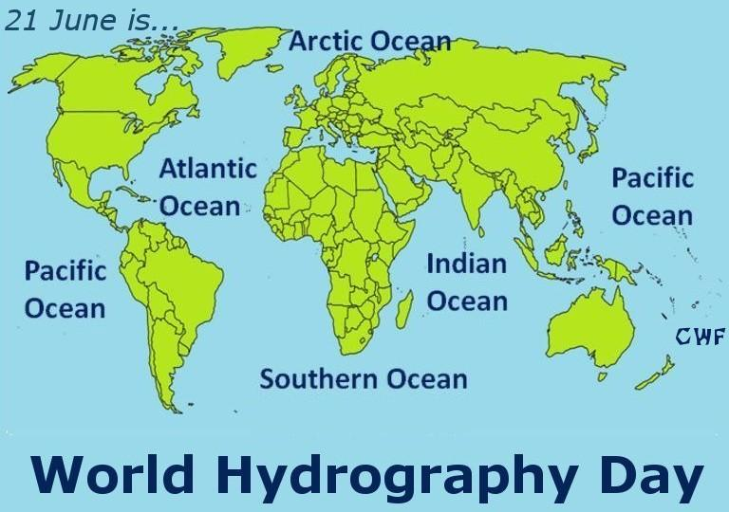

Slide 29
Set<Ocean> oceans =
new HashSet<>();
// Populate the set, and then...
String report = “”;
for (Ocean o: oceans)
report += o + “\n”;
Is this bad?
Creates 5 StringBuffers rather than 1

Slide 30
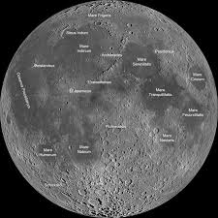
1 Ocean
22 Seas

Slide 31
Set<Ocean> oceans =
new HashSet<>();
// Populate the set, and then...
String report = “”;
for (Ocean o: oceans)
report += o + “\n”;
Is this bad?
Creates 28 StringBuffers rather than 1
Notes:
On behalf of historical accuracy …

Slide 32
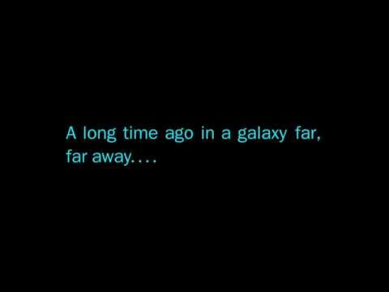

Slide 33
Apparently Wookiepedia is a thing

Slide 34
Set<Ocean> oceans =
new HashSet<>();
// Populate the set, and then...
String report = “”;
for (Ocean o: oceans)
report += o + “\n”;
Is this bad?
Creates 50,000,028 StringBuffers rather than 1

Slide 35
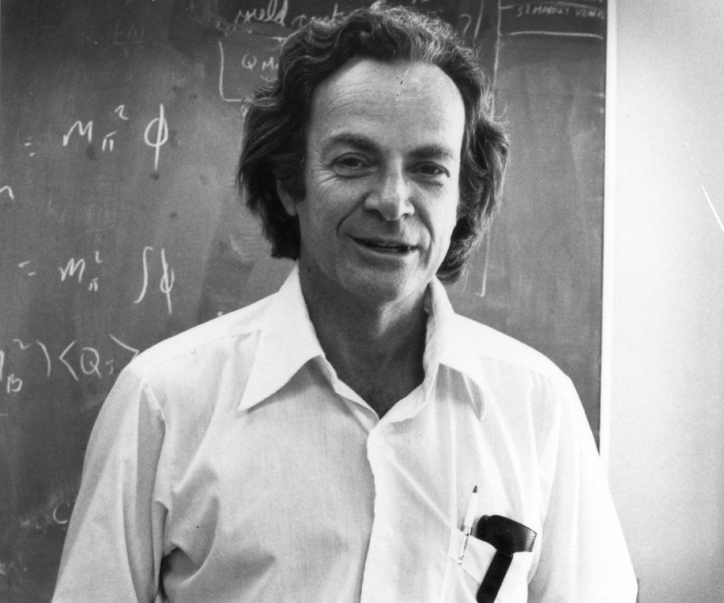
Richard Feynman Nobel Prize in Physics and FRS 1965

Slide 36
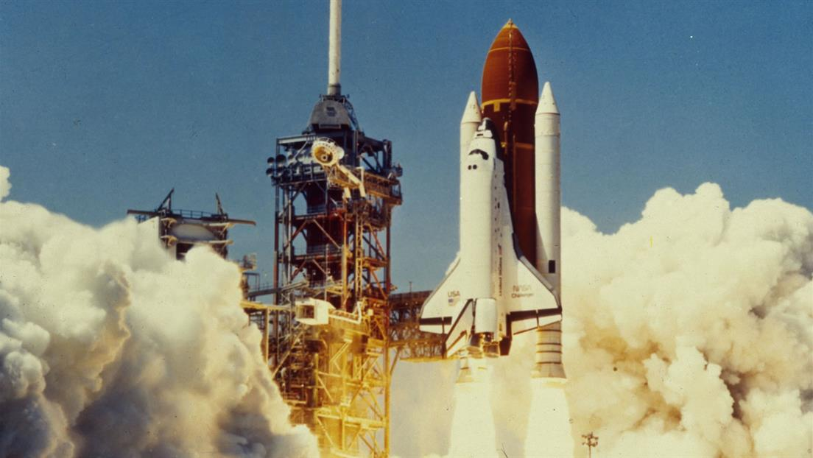
Space Shuttle Challenger: Jan 28, 1986

Slide 37
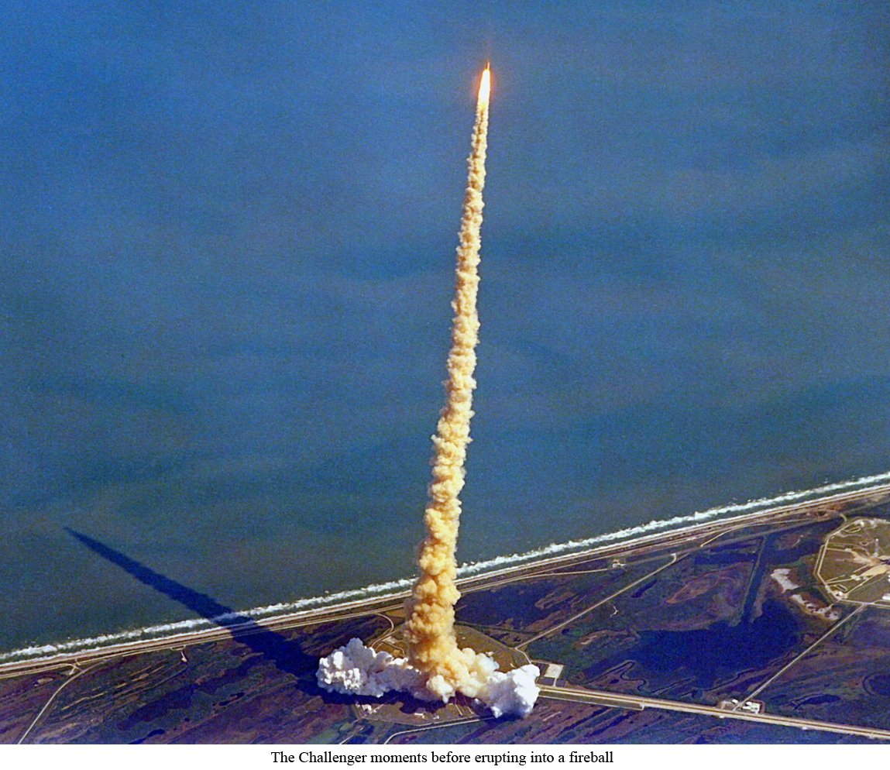

Slide 38
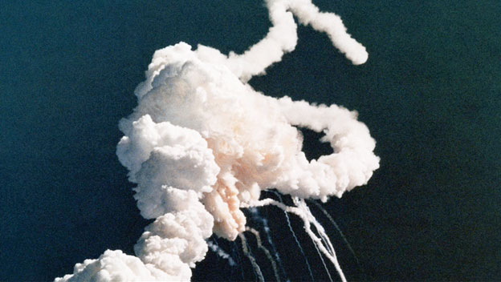
“The breakup of the vehicle began at T+73.162 seconds and at an altitude of 48,000 feet (15 km).”
-- NASA Internal Memo

Slide 39
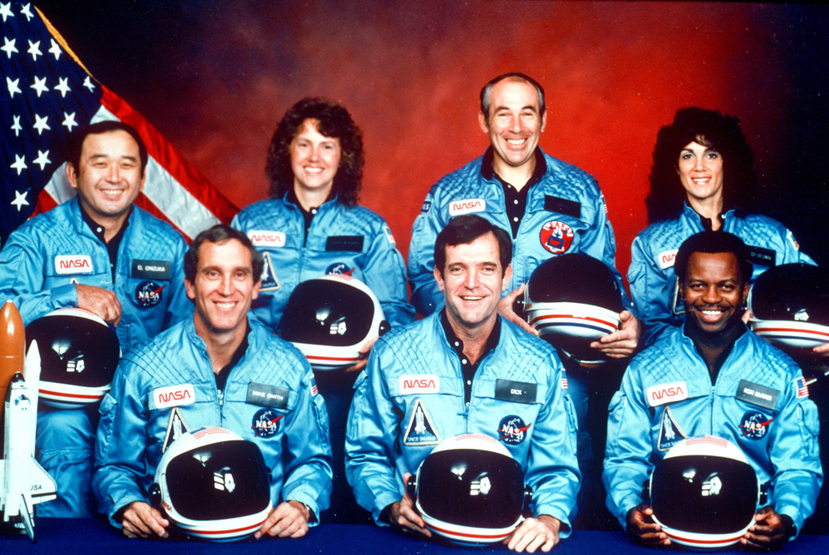

Slide 40
The investigation
Total denial of responsibility by NASA and all subcontractors
Elite commission tasked with figuring out what happened
No progress until …
The O-rings: rubber rings that keep hot gases inside
Launch day was very cold and wet
Some engineers claimed these conditions caused O-ring failure: loss of rubbery resilience
O-ring subcontractor claimed that’s impossible
And then Richard Feynman spoke up …

Slide 41
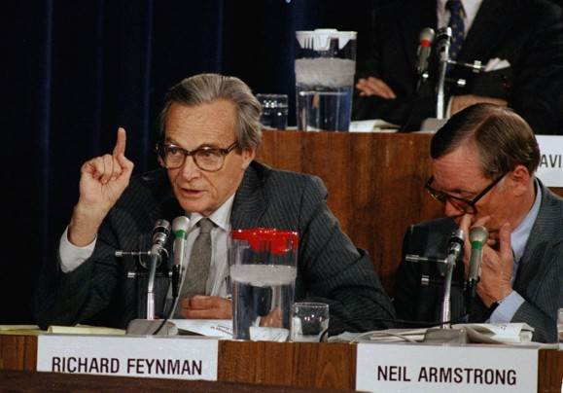
The most important
pitcher of ice water in
the history of science
https://www.youtube.com/watch?v=6Rwcbsn19c0

Slide 42
https://www.youtube.com/watch?v=6Rwcbsn19c0

Slide 43
Set<Ocean> oceans =
new HashSet<>();
// Populate the set, and then...
String report = “”;
for (Ocean o: oceans)
report += o + “\n”;
Is this bad?
Creates 50,000,028 StringBuffers rather than 1
Let’s try it!

Slide 44
What did we just learn?
Optimize what needs to be optimized.
Don’t add “moving parts” to your code just to save time that doesn’t matter.
Moving parts are bug risks.
Question what “they” say
Can you show that it’s wrong with common sense?
Or with a simple experiment using stuff you already have?

